Slide 1

Recap Our Learning
Slide A
Create a Big Ideas Poster
Big Ideas
We have learned a lot about what can affect the motion of objects and how those objects interact in a collision to cause damage or no damage.
Let’s take stock of what we have learned and record it on our Big Ideas poster.
Notes:
Reflect on previous lesson. Say, Well, it seems like we have done a lot of work learning about the factors that can affect the motion of objects and what occurs when objects make contact in a collision. We know all these factors contribute to the potential for damage in a collision. Let’s look back at our previous work as a class and create a list of our big ideas about these factors that affect the potential for damage in a collision.
Display the Big Ideas poster that was made prior to class. Project slide A. Place the Big Ideas poster in front of the class. Ask students to look back in their notebooks to their Progress Trackers at what they recorded for their last lesson. Explain that as students share what we have learned, you will record the big ideas on the Big Ideas poster.
Ask students, What was a big key take-away from our last lesson? Students should respond with the following ideas:
Friction and air resistance are contact forces.
Friction causes energy to be transferred to and from objects as they come into contact with each other.
Friction and air resistance decrease the kinetic energy of the moving object but increase the kinetic energy of the particles that make up the objects or subsystems the moving object comes into contact with (as well as on some of the surfaces of the moving object as well).
Take a moment to summarize into a shortened bullet point what students are saying:
Friction and air resistance affect a moving object’s kinetic energy.
Say, We also have some great ideas from Lesson 8 that we had discovered. What did we learn in Lesson 8 that we can include in our Big Ideas list?
Continue the process of having students share what we have learned as you summarize them into quick bullet points for students to reference. See the teacher guide for a list of bullet points by lesson as an example.

Slide 2
Revisit Collision Types
Slide B
The object that was damaged OR that you were surprised wasn’t damaged
Different Collisions Poster
The other object
A
was moving at first
was motionless
at first
Let’s look back at our collisions types poster.
B
was motionless
at first
was moving at first
C
was moving at first
was moving at first
Notes:
Say, Now that we have this great list of the big ideas we’ve discovered so far, let’s see if we can apply these to explain collisions from Lesson 1. Let’s look back at our Different Collisions poster.
Look back at the Different Collisions poster. Project slide B if students cannot see the Different Collisions poster well from their seats. Direct students to look at the Different Collisions poster. Point out that we had categorized 3 main types of collisions:
Collision type A: A moving object was damaged OR wasn’t damaged when it collided with a motionless object.
Collision type B: A motionless object was damaged OR wasn’t damaged when a moving object collided with it.
Collision type C: A moving object was damaged OR wasn’t damaged when it collided with another moving object.
Ask students if they think we can better explain why some objects broke in those collisions and others did not. Students should respond positively to this question.
Say, We will have a chance to revisit each collision type in small groups. Remember, we brainstormed related phenomena that went with each collision type in Lesson 1. We should go back and try to explain our real-world scenarios! We know that we cannot individually easily explain each and every collision mentioned on our Related Phenomena poster ourselves, so we can each pick one collision type and pick a related phenomenon that falls into that category. That way we can explain multiple collisions in one class period.

Slide 3
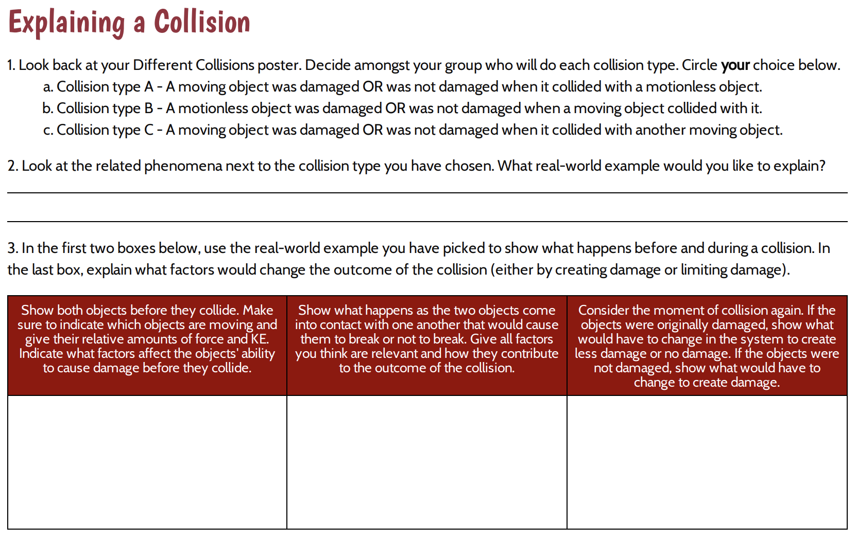
Explaining Different Collisions
Slide C
Notes:
Apply these big ideas to another collision phenomenon. Project slide C. Distribute Explaining a Collision. If the printable copy of Related Phenomena List was created in lieu of the Related Phenomena List on chart paper, pass it out at this time. Explain that Explaining a Collision will help them explain what happens before and during a collision that can contribute to damage or no damage occurring to the objects involved. Tell students that in a moment they will be divided into groups of 3, and each person will take a collision type to work with. The projected handout on slide C can be used to point out specific questions as the class goes over the handout together. On question 1 they will select which collision type they are individually focusing on in their groups. After the groups have delegated collision types, they will then get to choose their own collision from the Related Phenomena List or the printed copy of Related Phenomena List that has all of our different collisions listed from the Related Phenomena poster. On question 2, students will write what they have chosen as their related phenomena collision.
Point out that question 3 has a 3-series box that will need to be completed. The boxes are broken down into 3 basic categories:
Box 1- factors that impact movement before the collision
Box 2- what occurs during the collision to cause damage or no damage
Box 3- what factors would be altered to have the opposite outcome in a collision
Go over instructions for each box in question 3. Look closer at box 1 with students. Say, We now know that a lot of factors affect the objects before a collision. We also know that those factors affect the objects’ kinetic energy, which in turn will affect their potential for causing or experiencing damage in a collision. In box 1, make sure to draw a free-body diagram of each moving object and each nonmoving object. Be sure to show what factors affect the object before it comes into contact with the other object in a collision.
Move on to box 2 with students. Begin a discussion about whether to include forces such as friction and air resistance in box 2. Lead students to understand that this is not a needed part of the collision drawing for box 2. Example prompts and responses for this discussion can be found in the teacher guide.
Say, OK, so friction and air resistance are probably still at play on the objects during a collision, but the collision occurs over such a brief period of time that those forces are relatively weaker than the other contact forces in most collisions, so since they don’t really affect those objects as much as the other contact forces in a collision, let’s make sure that in box 2 we just focus on those contact forces that occur during the collision.
Instruct students to make a note of this beside box 2 if they feel they will need a reminder of this decision later.
Look at box 3 more closely with students. Explain that this box is meant for students to consider what factors would have to be changed to alter the outcome of the collision. If the object(s) did not break, explain what changes to the objects would have to occur to create damage in the collision. If the object(s) was damaged, explain what changes to the objects would have to occur to lead to no damage in the collision. In the latter case, make sure students know that they are drawing and explaining changes to the objects’ force and energy and not adding any protective materials or any other physical materials to the objects that have the function of protecting the object(s). Box 3 is asking what force and energy changes would have to occur to the objects to create a different outcome in the collision.
Group students and begin the task. Divide students into groups of 3. Remind students that each person in the group will be working on a different collision type. Before students start working, go to each group and confirm that each student is delegated a different collision type. Tell students that as they work they should reference the Big Ideas list and use their science notebooks as a reference to complete the task.
As students are working, circulate from group to group. Use this time to provide individual feedback in the form of questioning to guide students to the big ideas and representations needed in each box. Questions that can be used to help students work through the different boxes can be found in the teacher guide.
When students believe they are finished, use these questions to help them check their ideas:
Are the ideas on our Big Ideas list somewhere in your explanation in question 3?
Double-check kinetic energy. Are you showing the correct changes in kinetic energy from box 1 to box 2?
Check with another group member. Do you have similar ideas in boxes 1 and 2?
Allow students time to finish Explaining a Collision. Encourage them to compare ideas on question 3 with their group members as they complete their work.

Slide 4

Slide D
Feedback with Same Collision Types
Partner Feedback
Work with someone who has the same collision type as you. Share both of your ideas on question 3, then give feedback using the following questions:
What is similar about your boxes? What is different?
Do you agree or disagree on the factors that could change the outcome of a collision in box 3?
What changes would you suggest based upon your partner’s model?
After we have completed the feedback and revision process, you will turn in this handout to your teacher.
Notes:
Introduce collision type partner feedback process. Display slide D. After students have completed a first pass at filling out Explaining a Collision, tell students that they will get a chance to give and receive feedback on their ideas. Explain to students that they will find a person from another group with the same collision type. They will then share their specific phenomenon and show how they represented their ideas for question 3. After that, they can discuss similarities and differences in their representations and overall ideas using the guiding questions on slide D.
Say, After you have had a chance to share with your partner, you will get a chance to revise your ideas and make a stronger explanation based upon what you may have seen in your partner’s model or the feedback that your partner has given you. We will have a chance to get feedback twice, this time from someone with our same collision type, and then from someone with a different collision type. After we have completed our revision cycles, you will be turning this in.
Tell students that you will set a timer for 5 minutes to complete this feedback process. To help students find someone else who has the same collision type, ask students who have collision type A to raise their hand. Have students with their hands raised point to the person that they are going to engage in the feedback process with. It is OK to have one group of 3 if there is not an even number of students with that collision type. Repeat this selection process with collision types B and C. Once all students have a partner, instruct them to find a spot next to their partner and start the feedback process.
As students are giving feedback, circulate and remind students to use the guiding questions on the slide to help give feedback. After both partners have explained their ideas and given feedback, remind students to make any changes they feel necessary based upon the feedback they have received to question 3. Once students have completed this process, have them return to their seats.
Introduce the partner feedback process with a different collision type. Explain to students that now that we have had a chance to think about our own collision types, we also know certain factors can change the amount of damage in different collision types. A collision with just one moving object may have different interactions during the moment of contact than a collision with more than one object moving. Things like peak force, resistance, and kinetic energy may be shown differently for different collision types. Because we want to consider how different collisions result in damage or no damage, we really need to discuss our ideas with someone else who had a different collision type than the one we just explained. This may also help us explain more about the factors that might contribute to more or less damage in box 3.

Slide 5

Slide E
Feedback with Different Collision Types
Partner Feedback
Work with someone who has a different collision type than you. Share both of your ideas on question 3, then answer the following questions with your partner:
What is similar about your boxes? What is different?
Do the differences make sense based upon your different collision types? Why or why not?
Do you see anything in your partner’s boxes that you would like to add to your boxes?
What changes would you suggest based upon your partner’s boxes?
After we have completed the feedback and revision process, you will turn in this handout to your teacher.
Notes:
Project slide E. Tell students that the feedback process will be the same as the last round, with the exception of their partners and a couple of the questions. This time they will find someone who has a different collision type from a different group to share their ideas with. After both partners have shared their ideas, they will work together to answer the feedback questions on slide E and revise their ideas on question 3.
Have students get up from their seats and find someone who has a different collision type. Once students have found someone with a different collision type, students should start the feedback process using the questions on slide E. After both partners have explained their ideas and given feedback, remind students to make any changes to question 3 they feel necessary based upon the feedback they have received.
After the students have completed their feedback and the revision of question 3, have them hand in Explaining a Collision. Use this handout to gauge student understanding of variances that can occur to impact damage in a collision.
Say, Wow, we have really figured out a lot about collisions and damage! Next time, let’s see if we can answer any more questions from our DQB and then apply what we have figured out to a new scenario--baseball!

Slide 6

Slide F
Revisit the DQB
Turn and Talk
What areas of the DQB have we made progress on?
Are there any specific questions that we can now answer that we could not answer last time?
Be prepared to share your ideas with the whole class.
Notes:
Say, Last class we worked on applying our knowledge to explain how each collision type worked and why some collisions caused damage or not. Let’s see if we can apply some of the ideas from our Big Ideas poster to answer more questions on our DQB.
Project slide F. Ask students to meet in a semicircle around the DQB. Have students turn and talk about the following questions:
What areas of the DQB have we made progress on?
Are there any specific questions that we can now answer that we could not answer last time?
Ask students to share whether we have made any progress on an area of the DQB. Students should respond that we have made progress on areas related to the movement of objects, friction, air resistance, damage, increases in mass vs. speed, peak forces, and KE. Pick one section that students feel we have made progress on and pull a question from that grouping. Read the question out loud and ask students what we can say is the answer to that question. Once the question is answered, put a check mark on the corner of the sticky note. If it is determined that all the questions in that section can be answered, place a larger check mark in the area of the section to indicate that the larger group has been answered. After a couple of individual questions have been answered from each section identified by students, start checking off full groups of questions that students feel we have made progress on.
After this process has been completed, most areas of the DQB should have large check marks next to them. There should still be a section remaining about materials and how those materials contribute to a reduction of damage in a collision. Point out this section to students.
Say, It seems that we still have a section left over about materials and protecting objects. We will definitely have to revisit that and figure out how some materials work and seem to protect objects better than others. Figuring that out also seems to lend itself to an engineering approach to developing solutions that can help protect objects from getting damaged in a collision. But before we start down that path of questions and ways to investigate them, let’s make sure we can apply our current understandings to another set of collision-related phenomena. Let’s prepare to do that in the context of another sport, this time related to baseball.
I found some interesting claims, data, and questions related to baseball game play that involve collisions. I’d love to share them with you and see if you can use what we figured out to explain these as well.

Slide 7
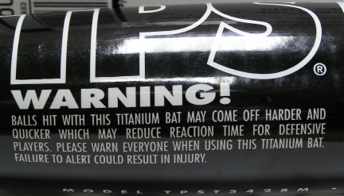
Slide G
Lesson 10 Assessment
We’ve learned a lot about damage and collisions. Let’s see if we can apply our new learning to a baseball scenario!
Do your best to answer the questions on the assessment.
When you are done, turn in the Lesson 10 assessment to your teacher.
Notes:
Distribute Baseball Assessment 1 or Baseball Assessment 2. Project slide G. Read over the scenario with students. Direct students to put their name at the top of the paper and read through the questions together. Answer any clarifying questions students may have about the assessment.
Ask students to complete Baseball Assessment 1 or Baseball Assessment 2 on their own. Collect the assessment when students are finished.
Say, We have learned a lot about collisions, but we still seem to have questions about the materials in a collision. I was looking back at our phone-breaking problem and recalled some interesting data from our first lesson about phones that were protected and still broke! We will revisit those data in our next class.

